Slide 1
Homework 1 (Due: 3/4)
繳交組員名單

Slide 2
Homework 2 (Due: 3/11)
Input a color image C(R,G,B)
Output the color image C
3. Transform the color image C into a
grayscale image I by I = (R+G+B)/3
4. Show the grayscale image I.

Slide 3
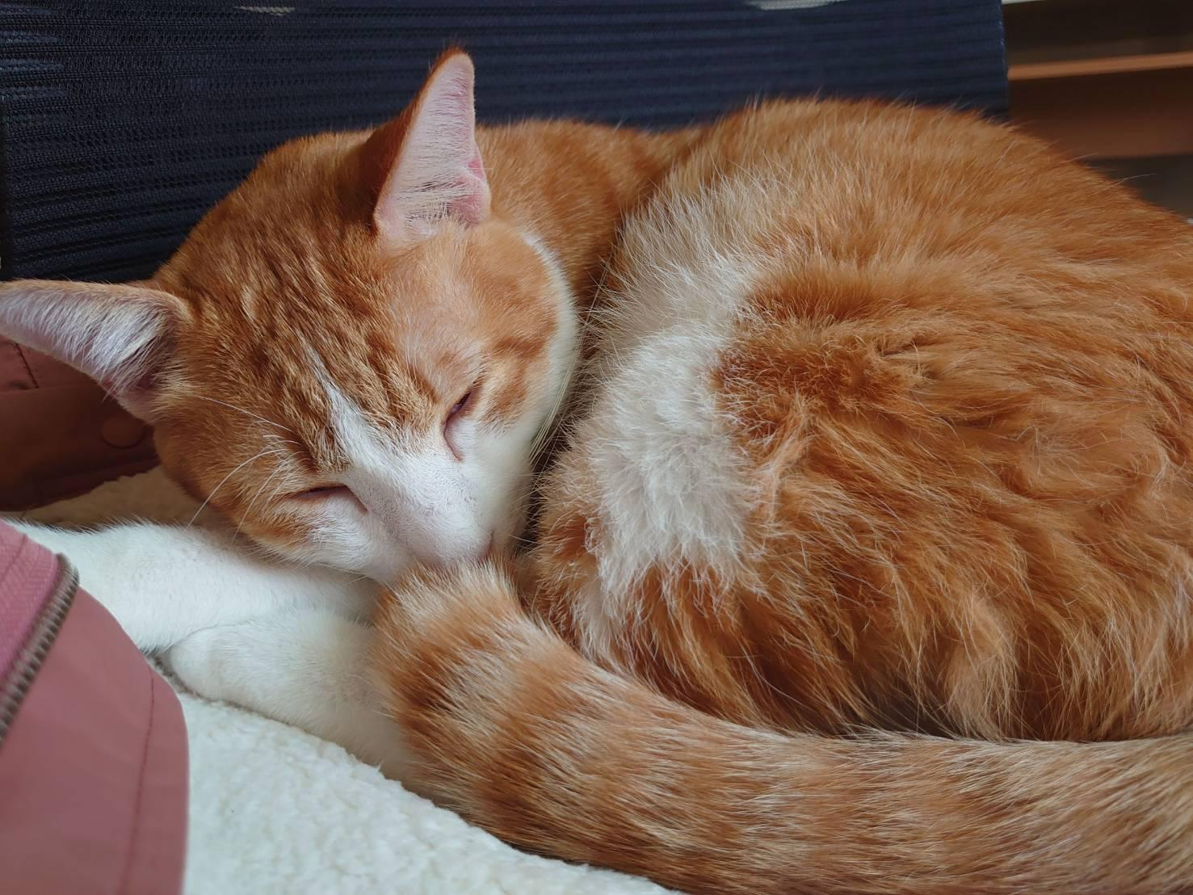

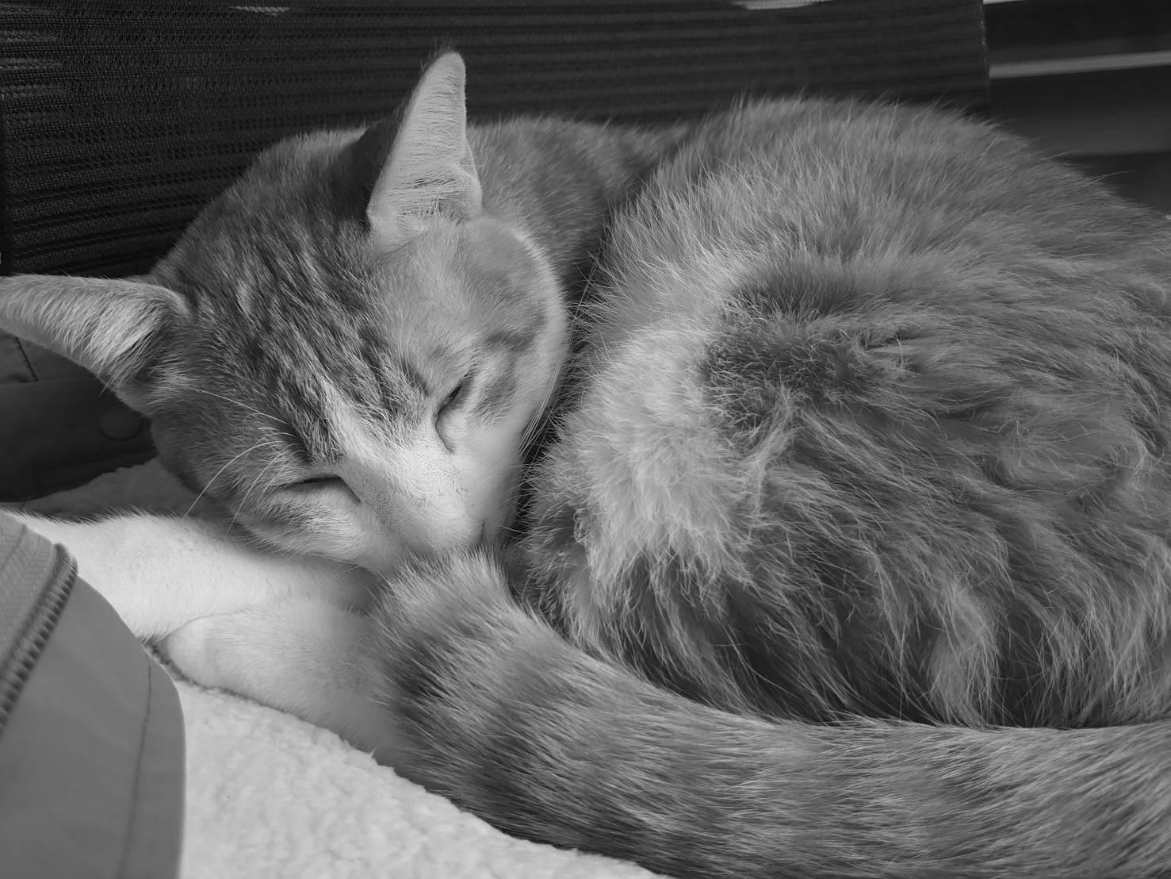
Homework 2 (Due: 3/11)
Experimental results:
Input color image C
Output color image C Grayscale image I

Slide 4
Homework 2 (Due: 3/11)
Source code
from PIL import Image # use pillow library
im = Image.open('./input.jpg’) # load image
copy = im.copy() # copy image
copy.save('./output.jpg’) # save the copy image
pixels = im.load() # load pixels in the image
for i in range(im.size[0]): # for each column
for j in range(im.size[1]): # for each row
rr, gg, bb = pixels[i, j]
gray = int((rr + gg + bb)/3)
pixels[i, j] = ( gray, gray, gray) # pixel = (R+G+B)/3
im.save('./grayscale.jpg’) # save image as grayscale.jpg
im.show() # show grayscale image

Slide 5
Homework 2 (Due: 3/11)
Comments：
In the python library, pillow, it have a more quickly
method to change an image into grayscale.
( im = Image.open('./input.jpg’).convert(‘LA’) )
But the question is the convert formula is
which is from official ducument.(Link)
So, the code on the previous page is to edit the pixels one by one in order to make sure that I = (R+G+B)/3
There is my github, you can clone the sorce code there.
L = R * 299/1000 + G * 587/1000 + B * 114/1000

